Slide 1

C graphics

Slide 2
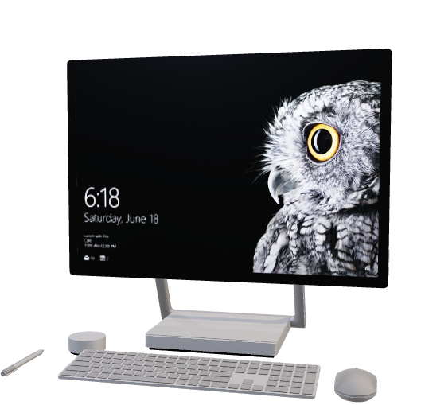
INTRODUCTION
Using the C programming language, graphical user interfaces (GUIs) and other visual components are developed.
In C graphics programming, you typically commence by initializing a graphics mode and creating a visual canvas or window where you can create drawings and show different objects. By modifying their positions, sizes, and colours, you can construct shapes like lines, circles, rectangles, and polygons.
Transformations (which include rotation and scaling), animations, and interaction with the user through mouse and keyboard input are a few instances of advanced features. Simple static images to advanced video games, computer simulations, and tools for data visualization are numerous instances of graphics applications.

Slide 3
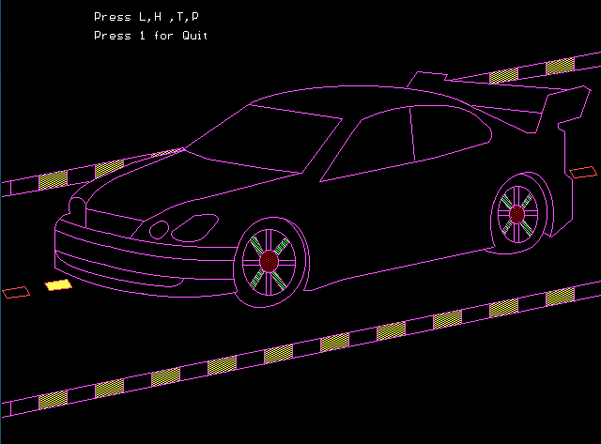
DESCRIPTION
CAR
Graphics Initialization:
Initializes the graphics system using initgraph.
Sets the background color to black using setbkcolor.
Drawing the Car:
Uses various graphics functions (lines, ellipses, etc.) to draw the shape of a car.

Slide 4
DESCRIPTION
Text Display:
Displays text on the screen using outtextxy to prompt the user to press keys.
Instructions are given for pressing keys 'L', 'H', 'T', and 'P’.
User Input:
Waits for user input in an infinite loop using while(1) and checks for key presses using kbhit().

Slide 5
DESCRIPTION
Key Press Handling:
If '1' is pressed, the program exits.
If 'H' is pressed, a horn sound is played using sound() and nosound().
If 'T' is pressed, a colorful animation is displayed on the screen.
If 'L' is pressed, the lights of the car and road are animated.
End of Program:
The program ends with a small graphical circle and a beep sound.

Slide 6
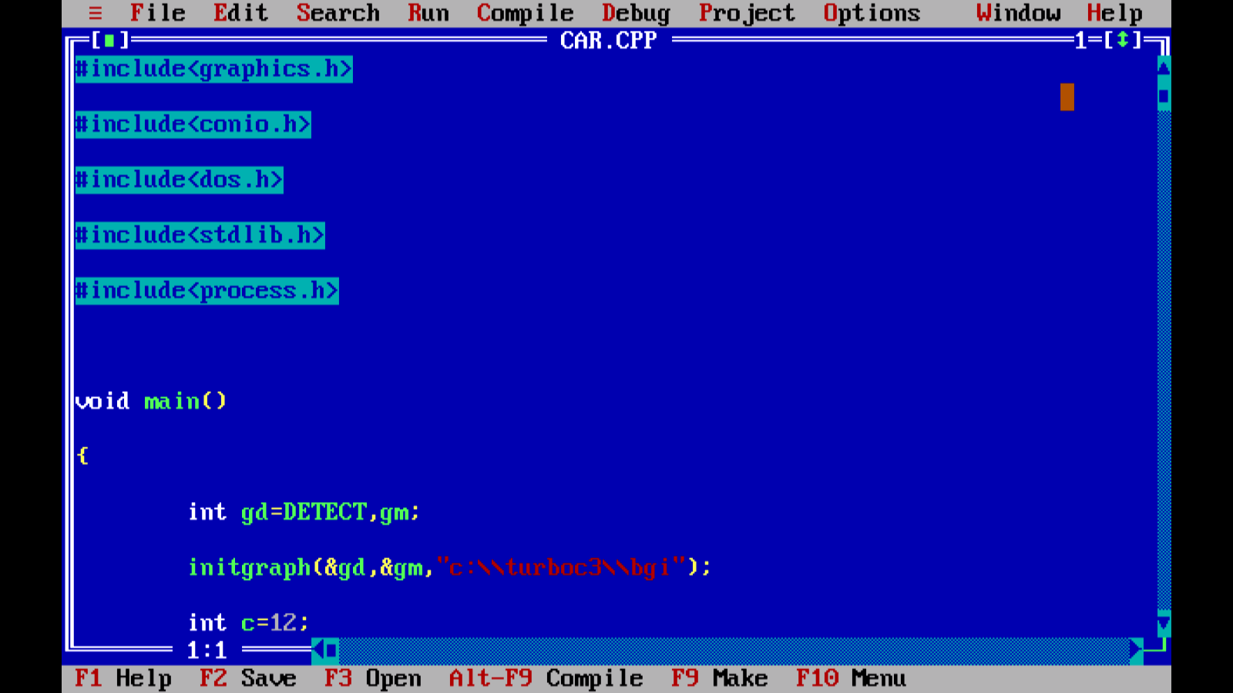
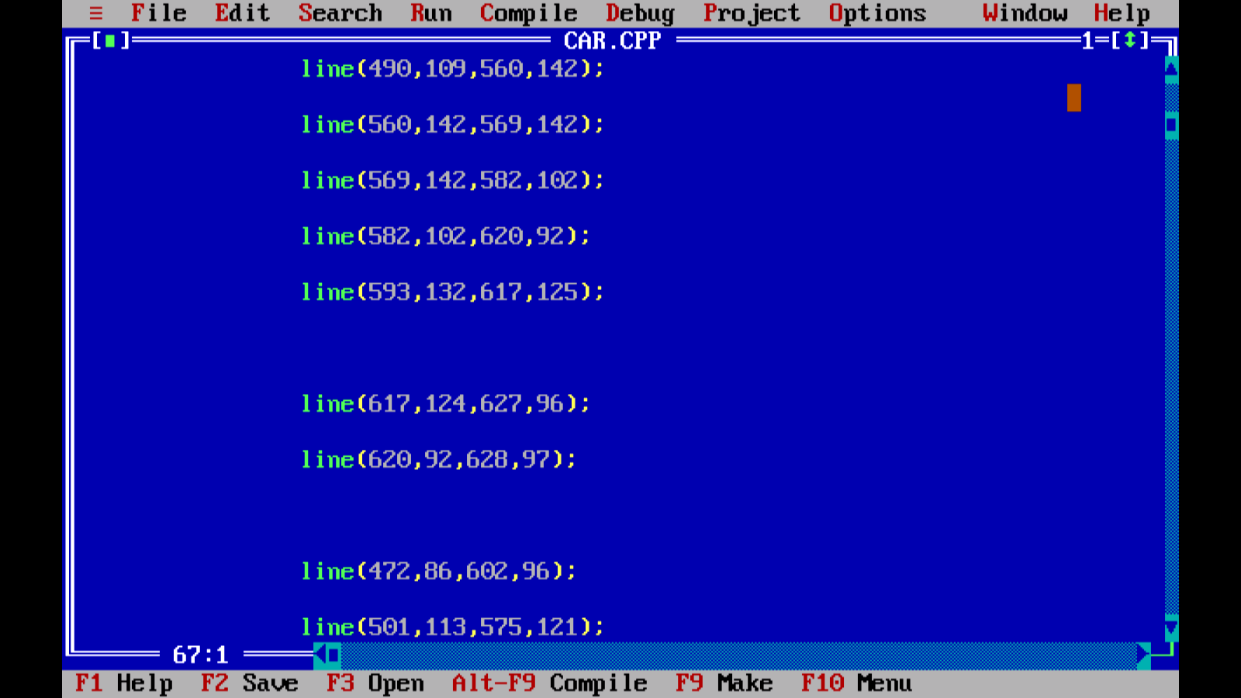
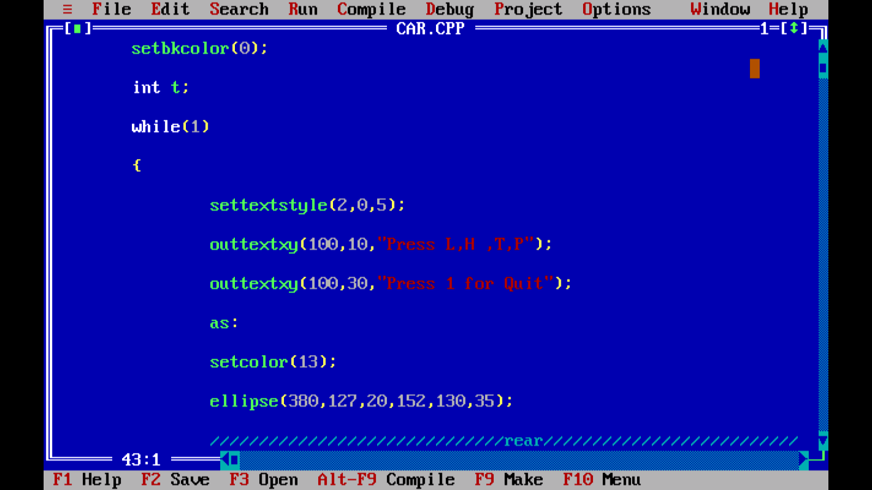
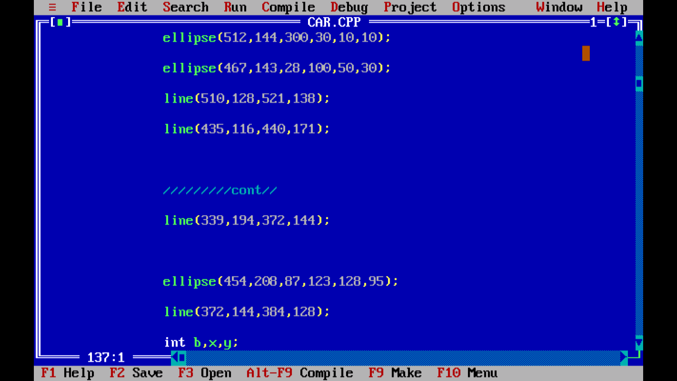
CODE

Slide 7
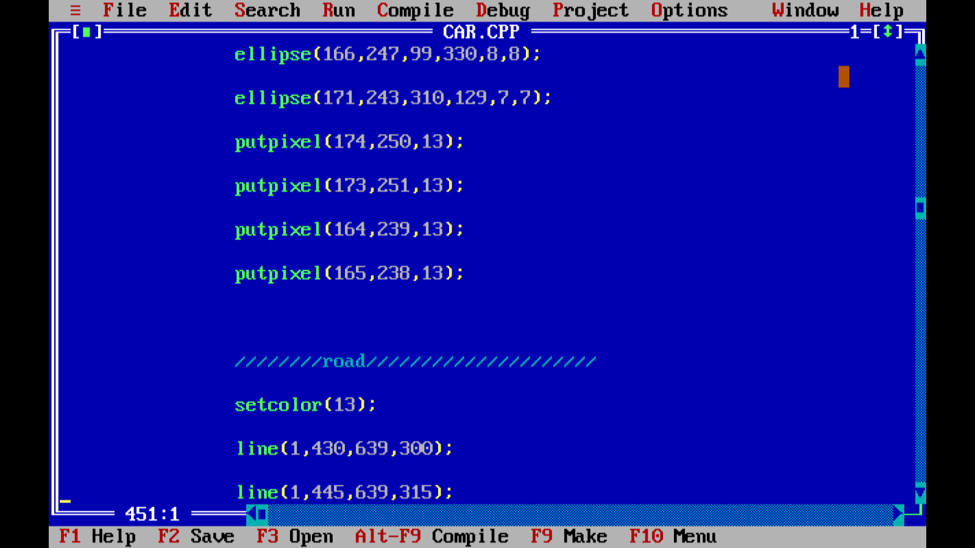
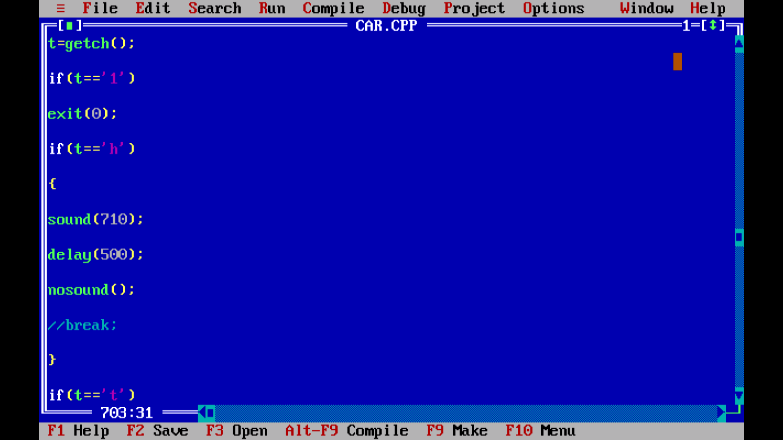
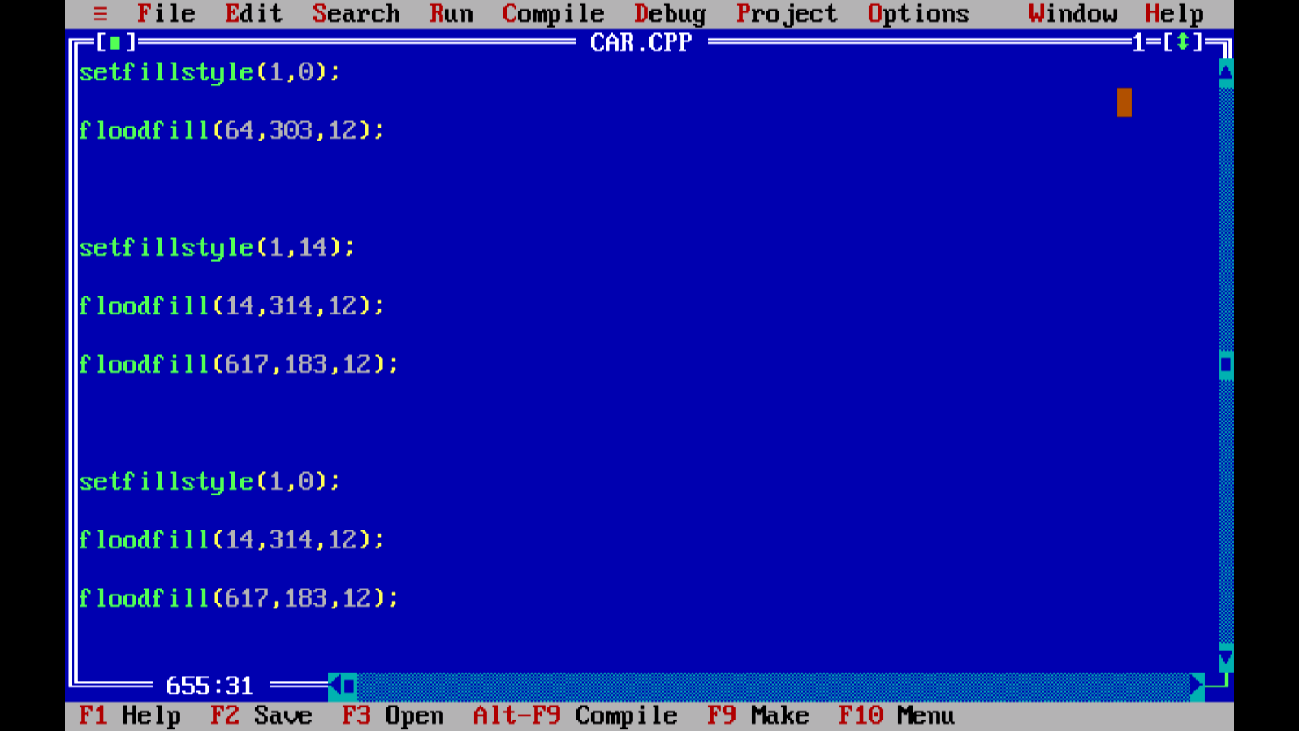
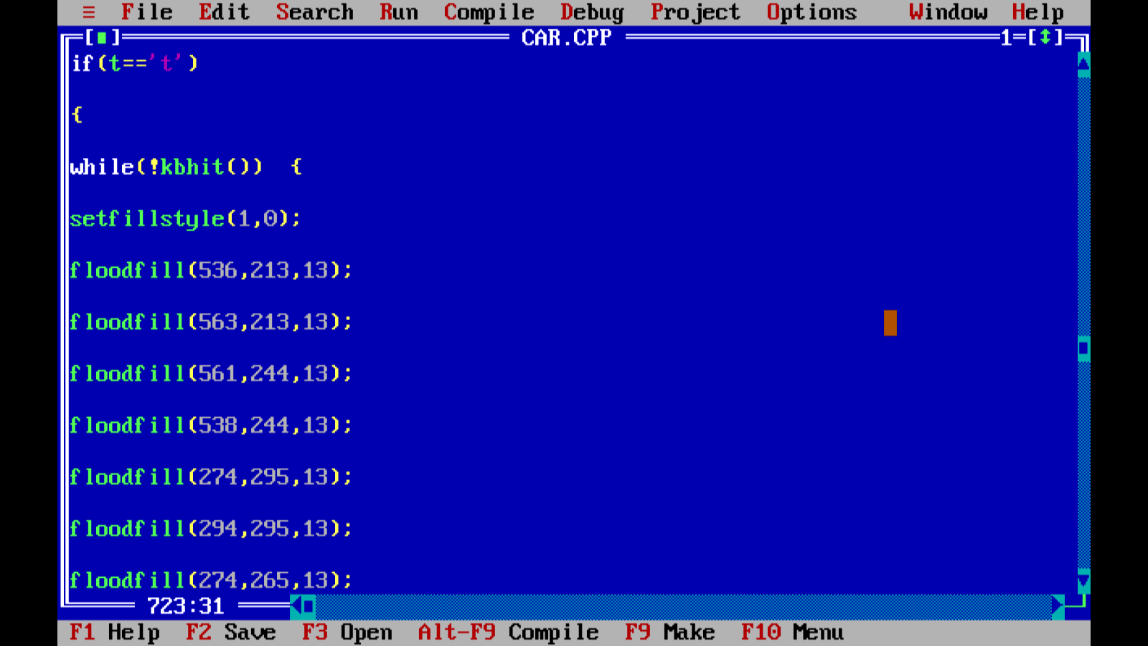
CODE

Slide 8
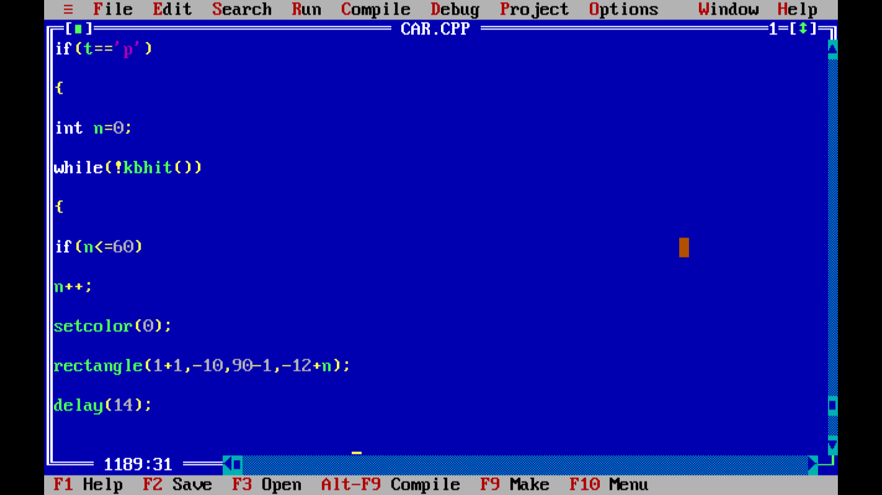
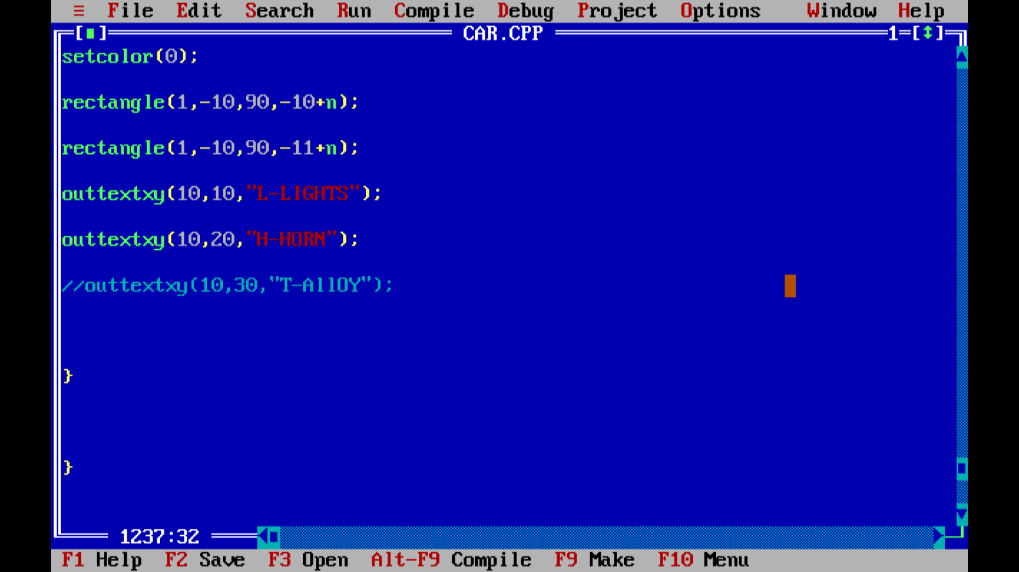
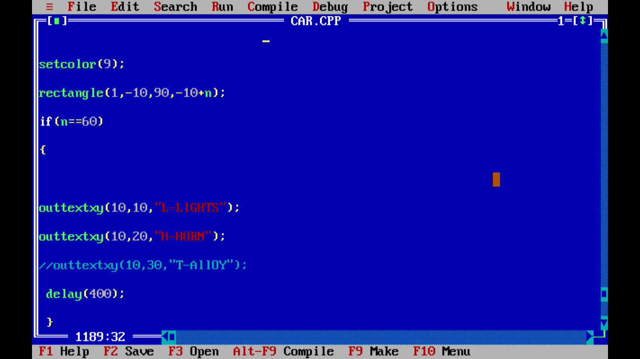
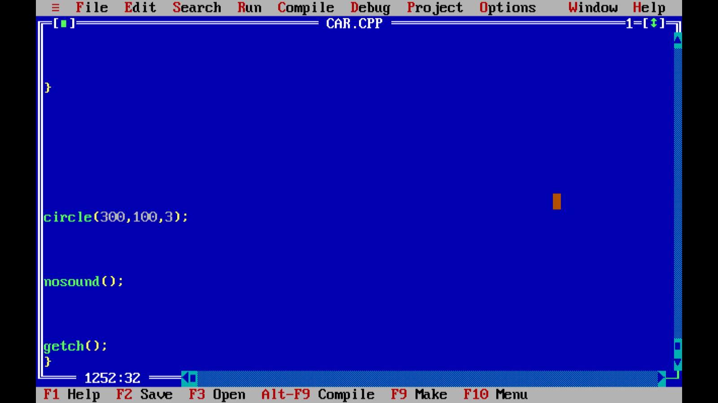
CODE

Slide 9
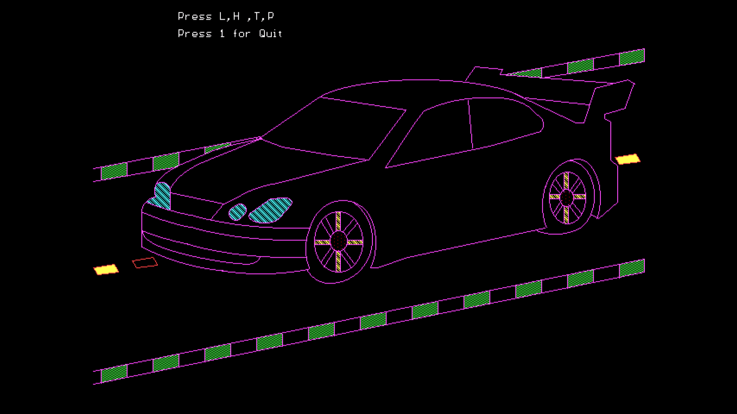
OUTPUT

